Slide 1
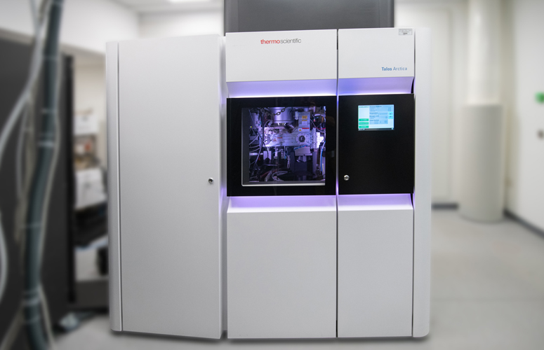
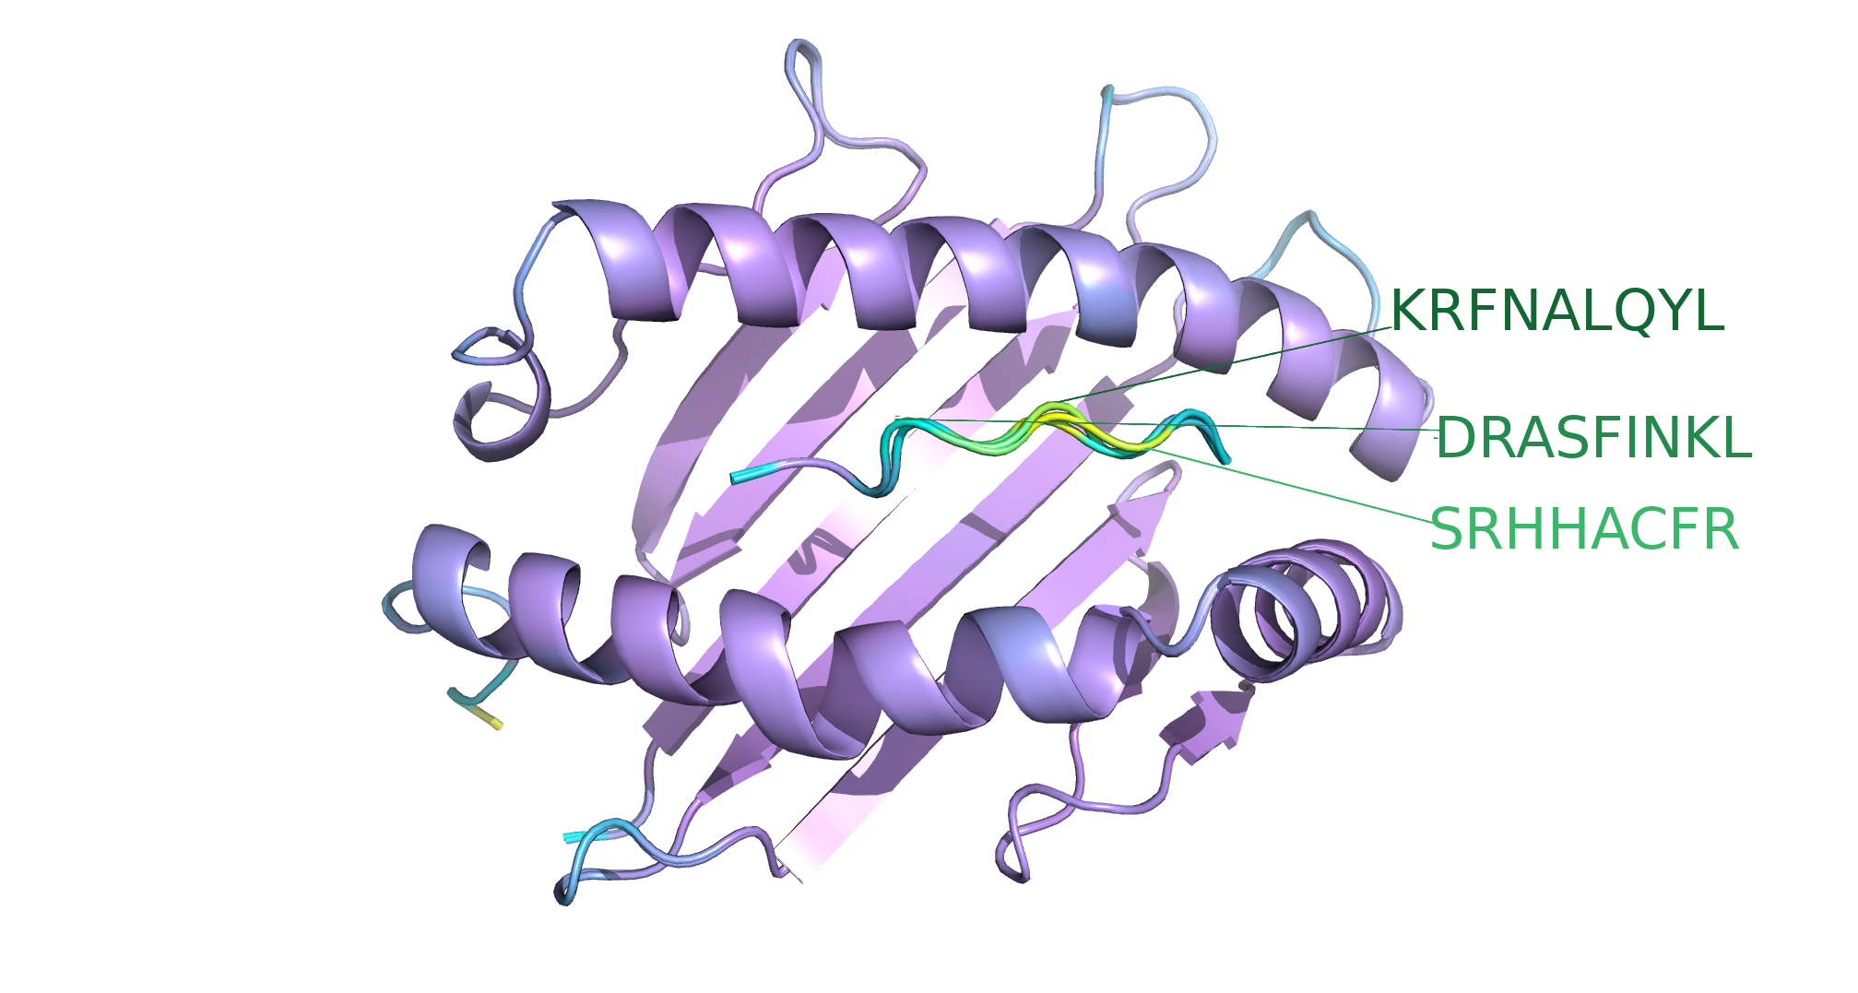
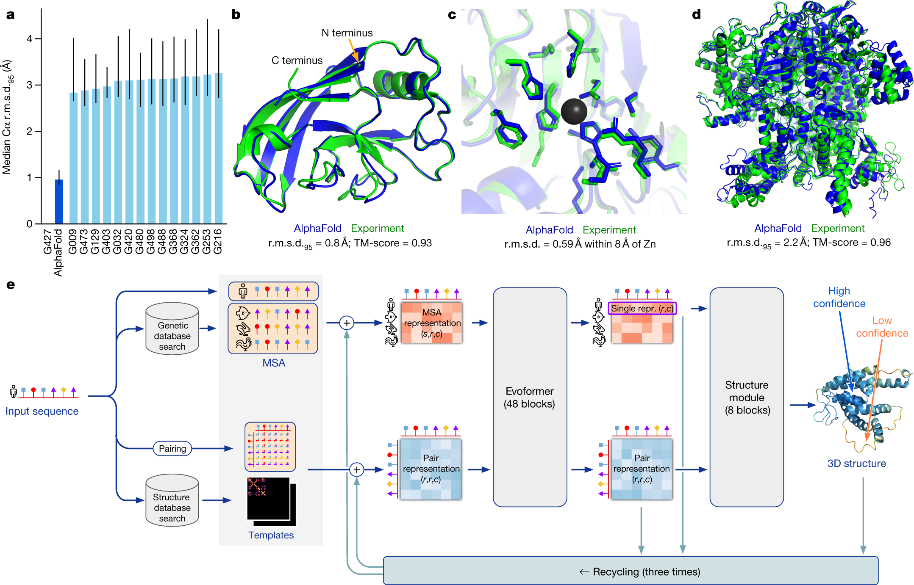
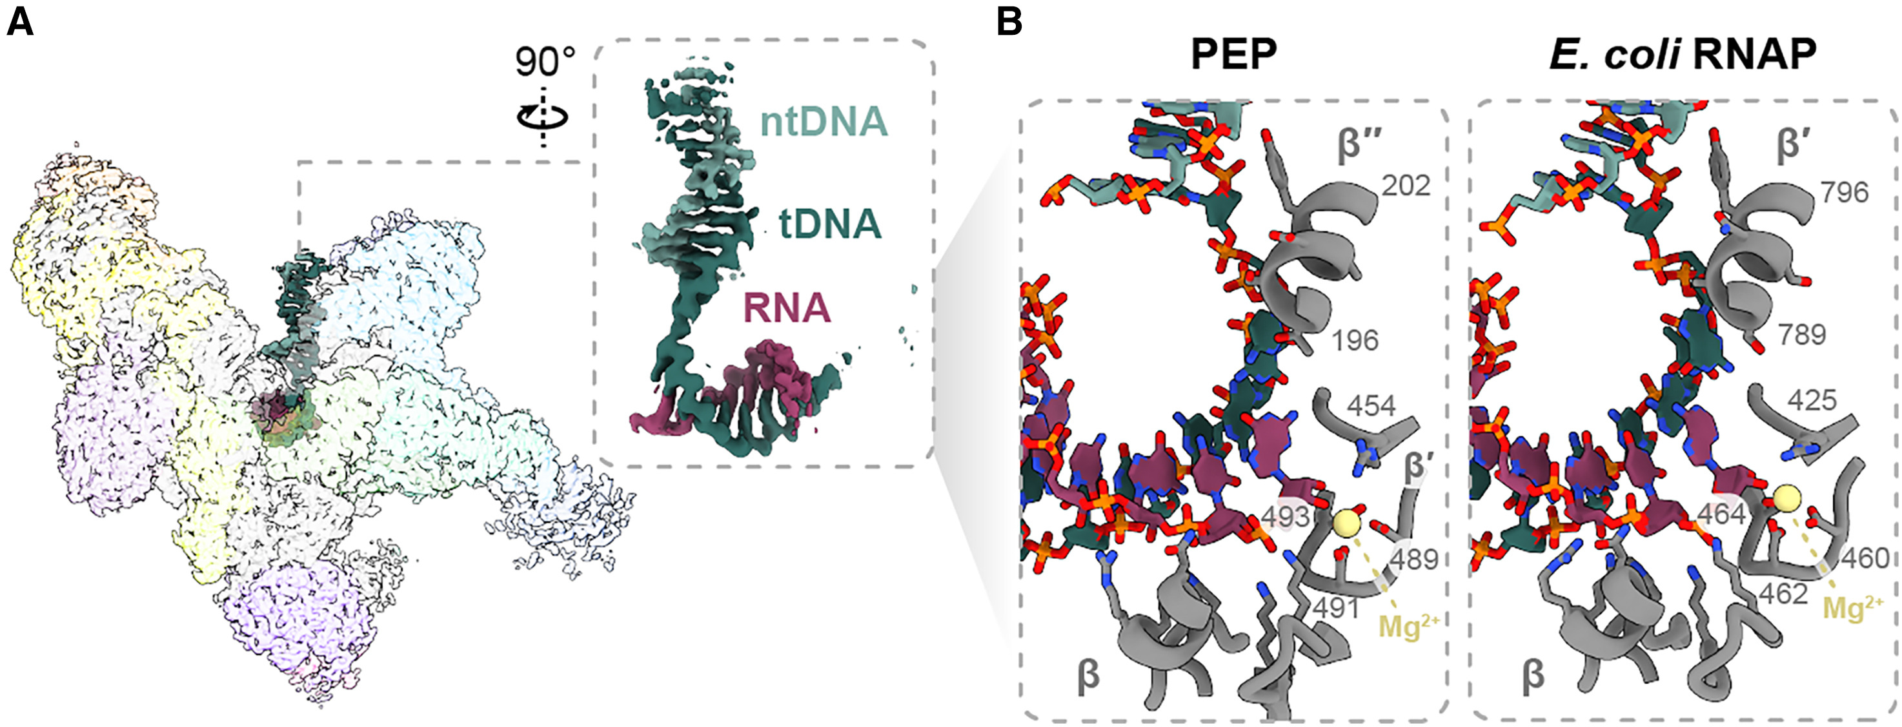

Computational revolution in Structural Biology
ResTech All Hands Meeting: 2024 July 13
Dr Keiran Rowell
From Instrument
To Clinic
From Computer
To Science

Slide 2
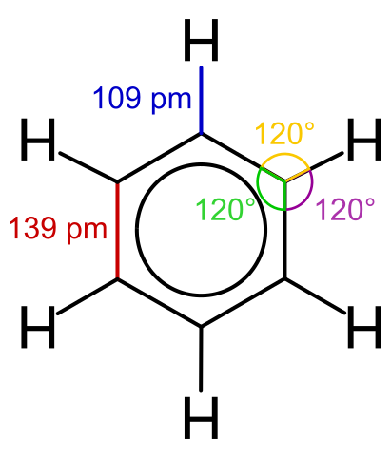
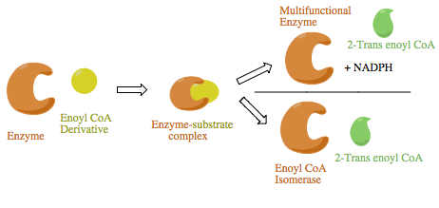
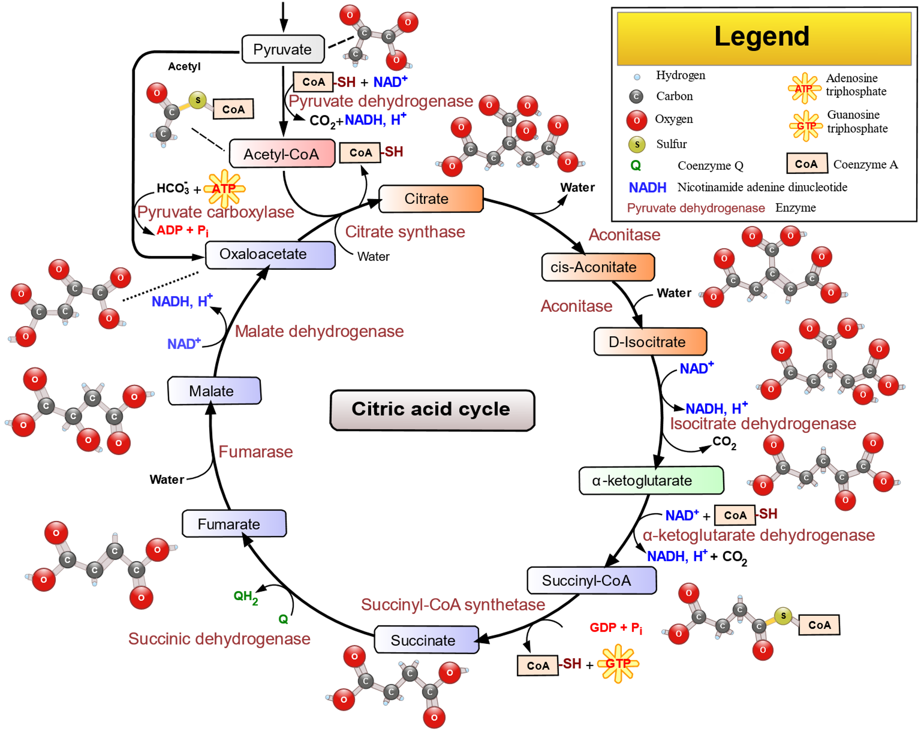
Structural Biology & Modelling
Molecules: 3D, represented by many models
​'Chemical Accuracy' - models go beyond ​
depictions, determine behaviour​
Depends on application:​
Reaction energies: 1/100th of bond strength energy​
Protein structures: 0.1-0.3 nm 'atomic resolution' ​
Structural Evolution: 1-in-1-billion spatial alignments
Structures 'hand-made' -> routine in the last 3 years​
​
Comp. Struct. Bio. was academic, now determines science​

Slide 3

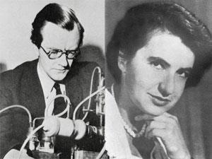
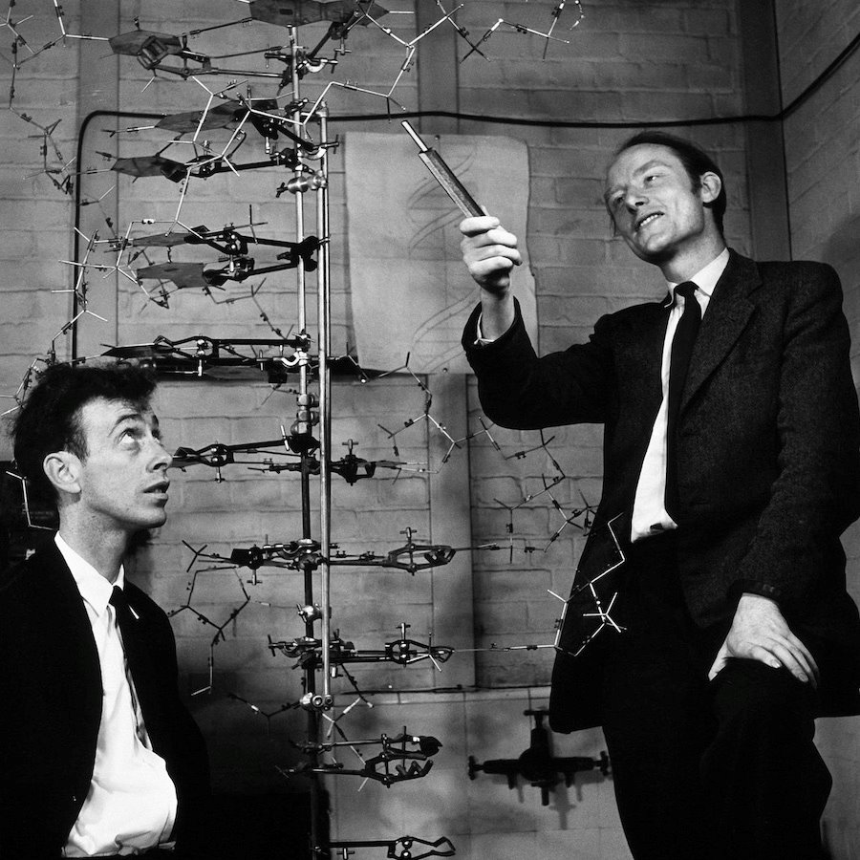
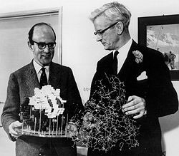
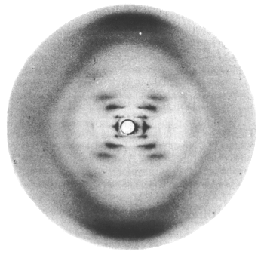
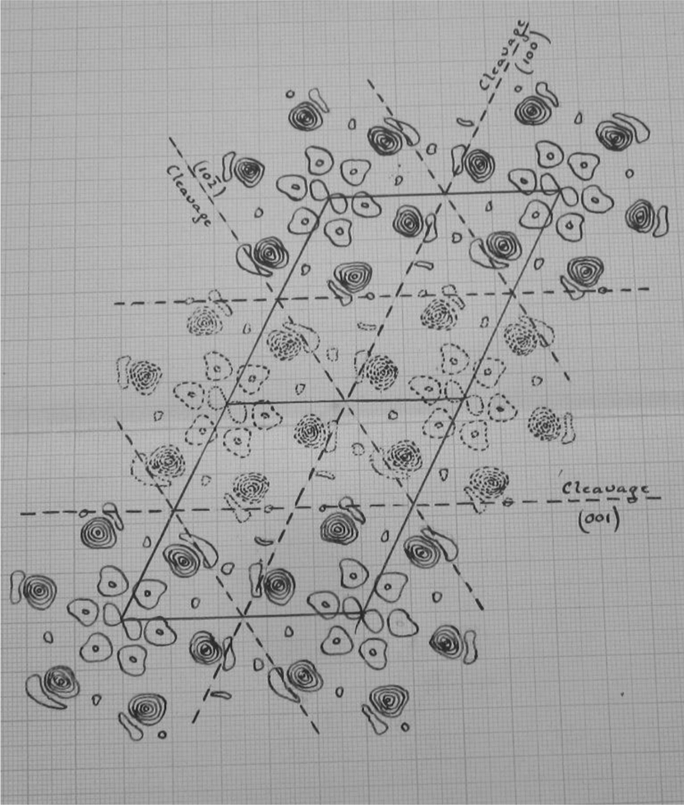
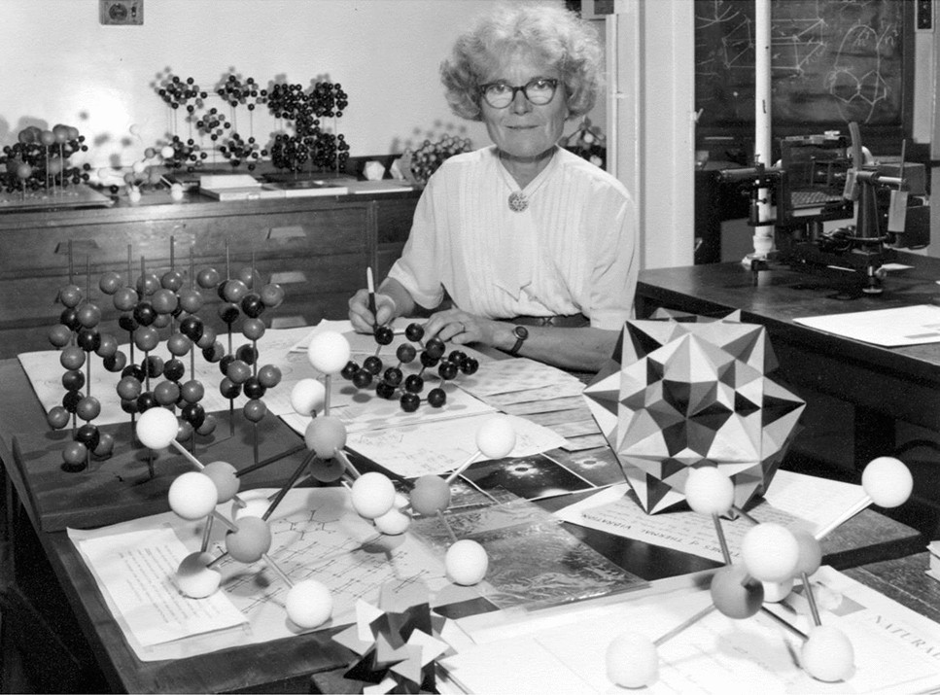
Models in Chemical Biology - function follows chemical form
Schrödinger speculates on
the molecules of life 1944
Perutz & Kendrew's model of the 3D structure of a protein (myoglobin) 1957 ​
Watson & Crick's DNA double-helix model 1953
Wilkins & Fraklin's X-ray diffraction images of DNA 1953
Kathleen Lonsdale resolves the structure of benzene 1924

Slide 4
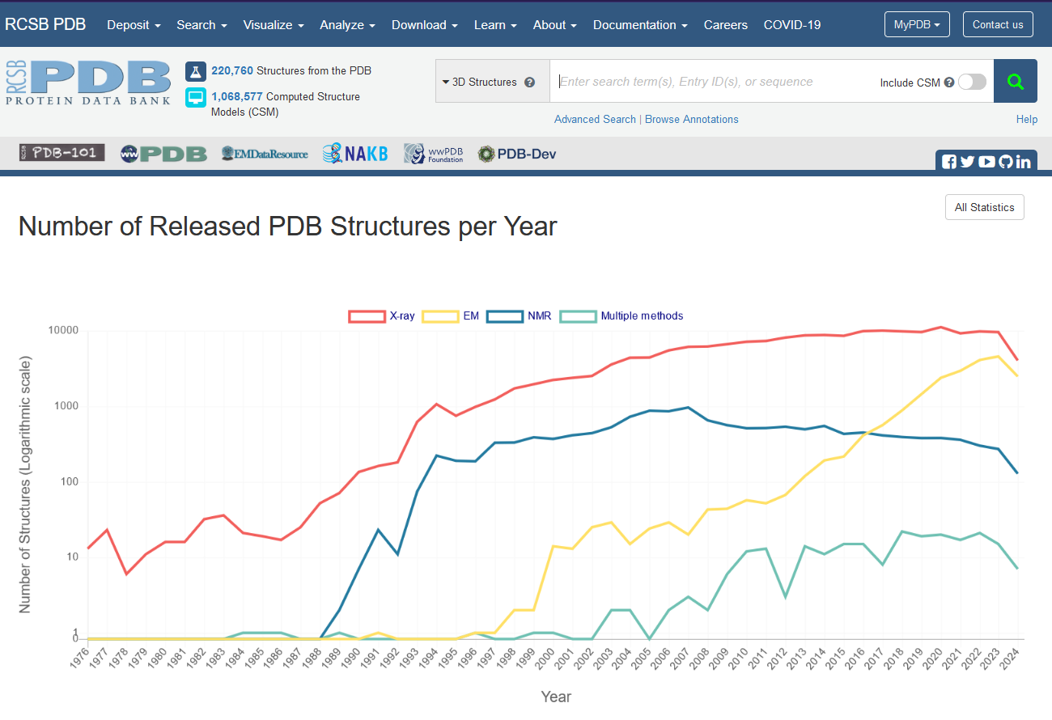
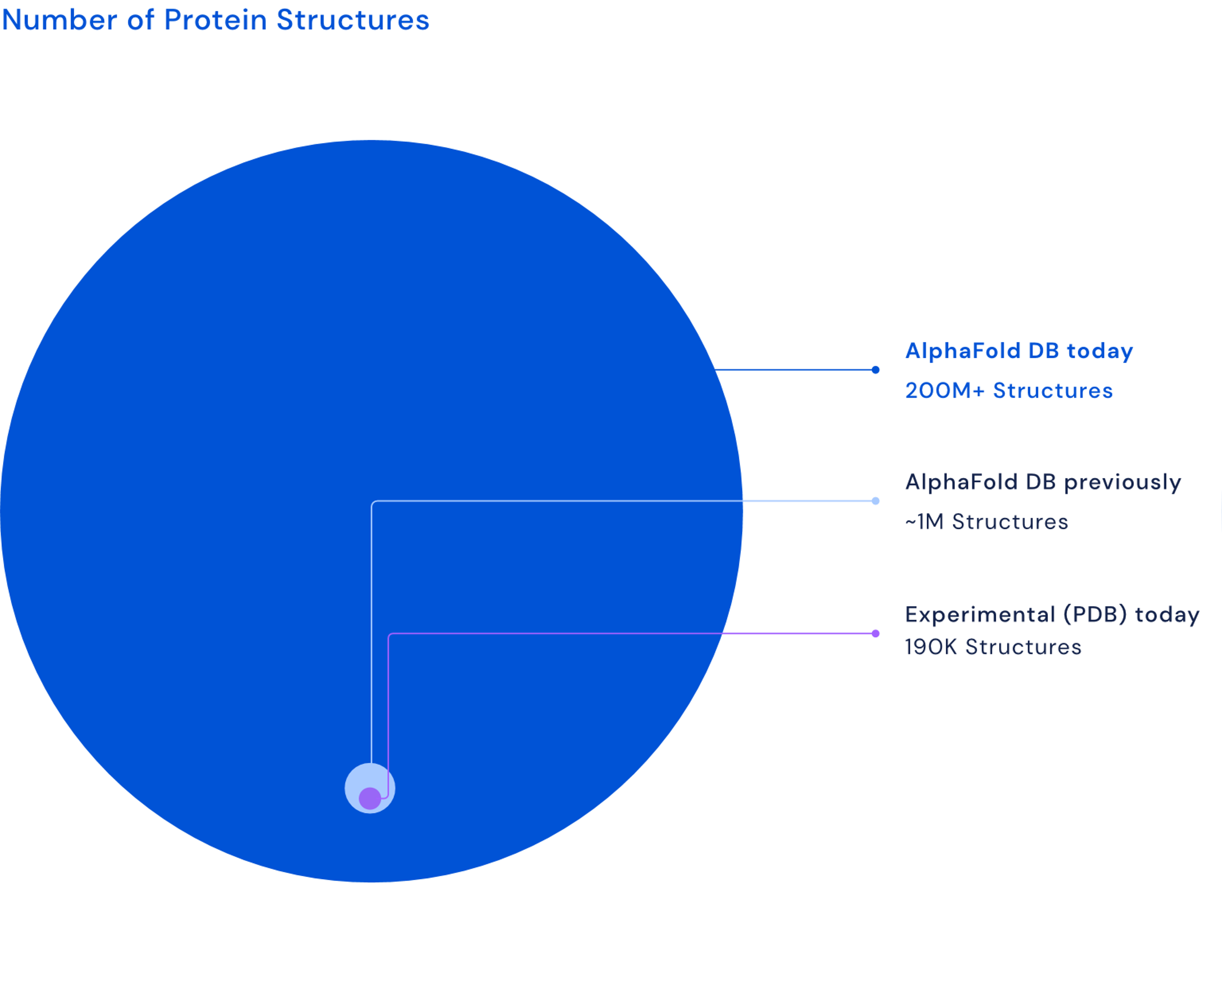
X-rays ruled 20thC – CryoEM & Calcs the 21st
Compute power – Moore's law + DNA Sequencing – super-Moore's law +
Deep Learning – context scaling laws
=
Comp.Struct.Bio. - 1000x in 2 years

Slide 5
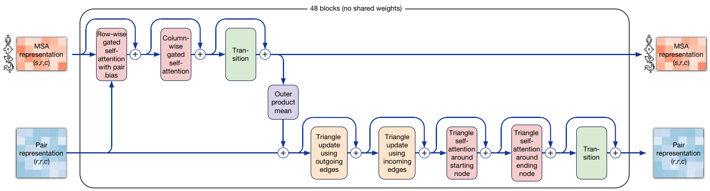
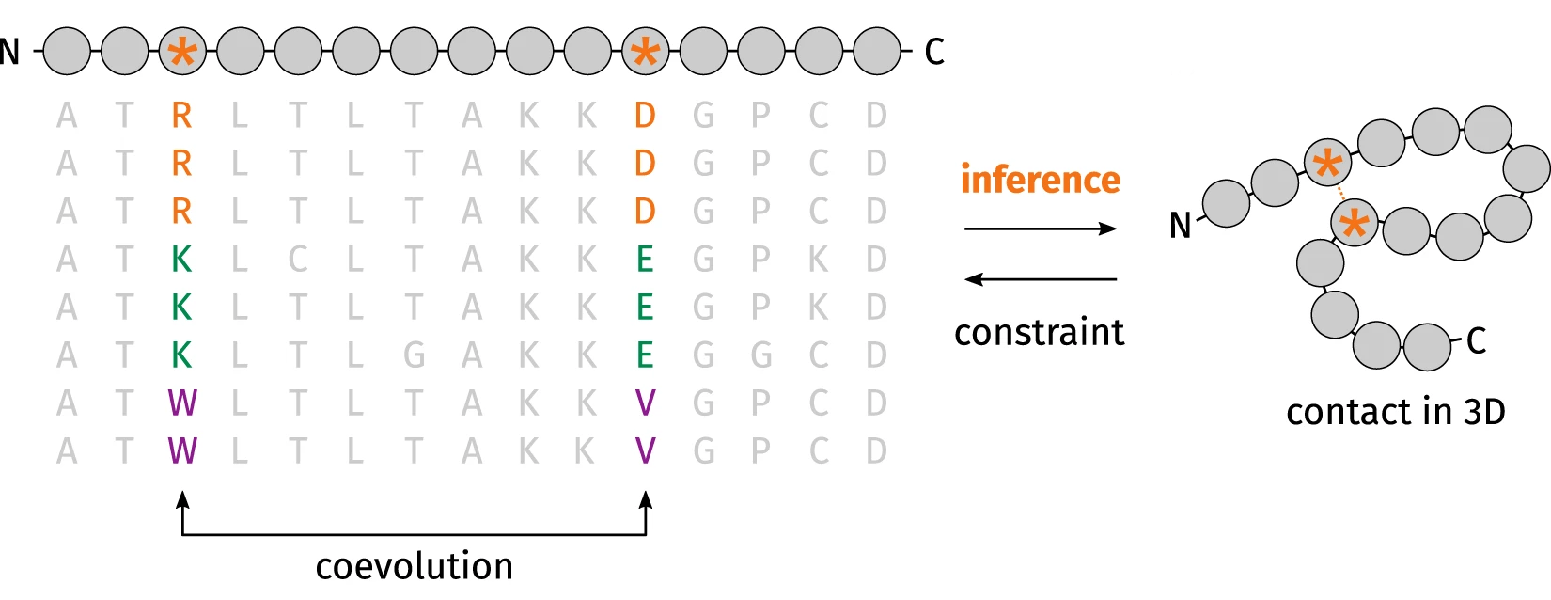
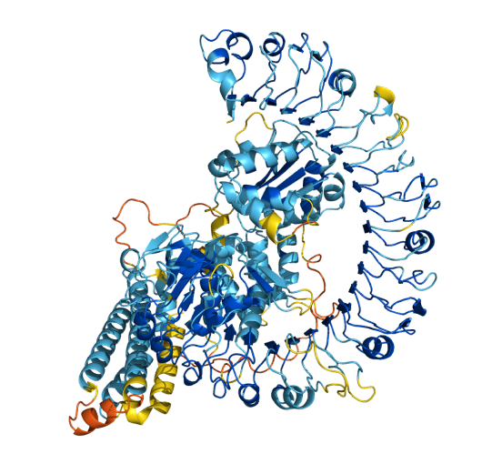
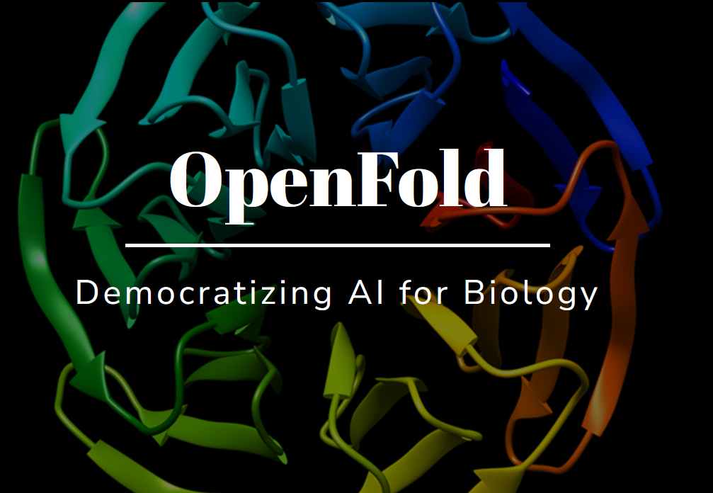
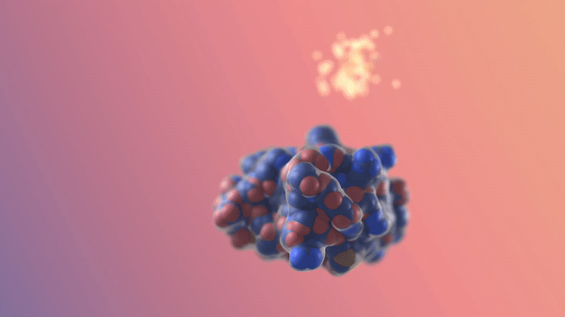
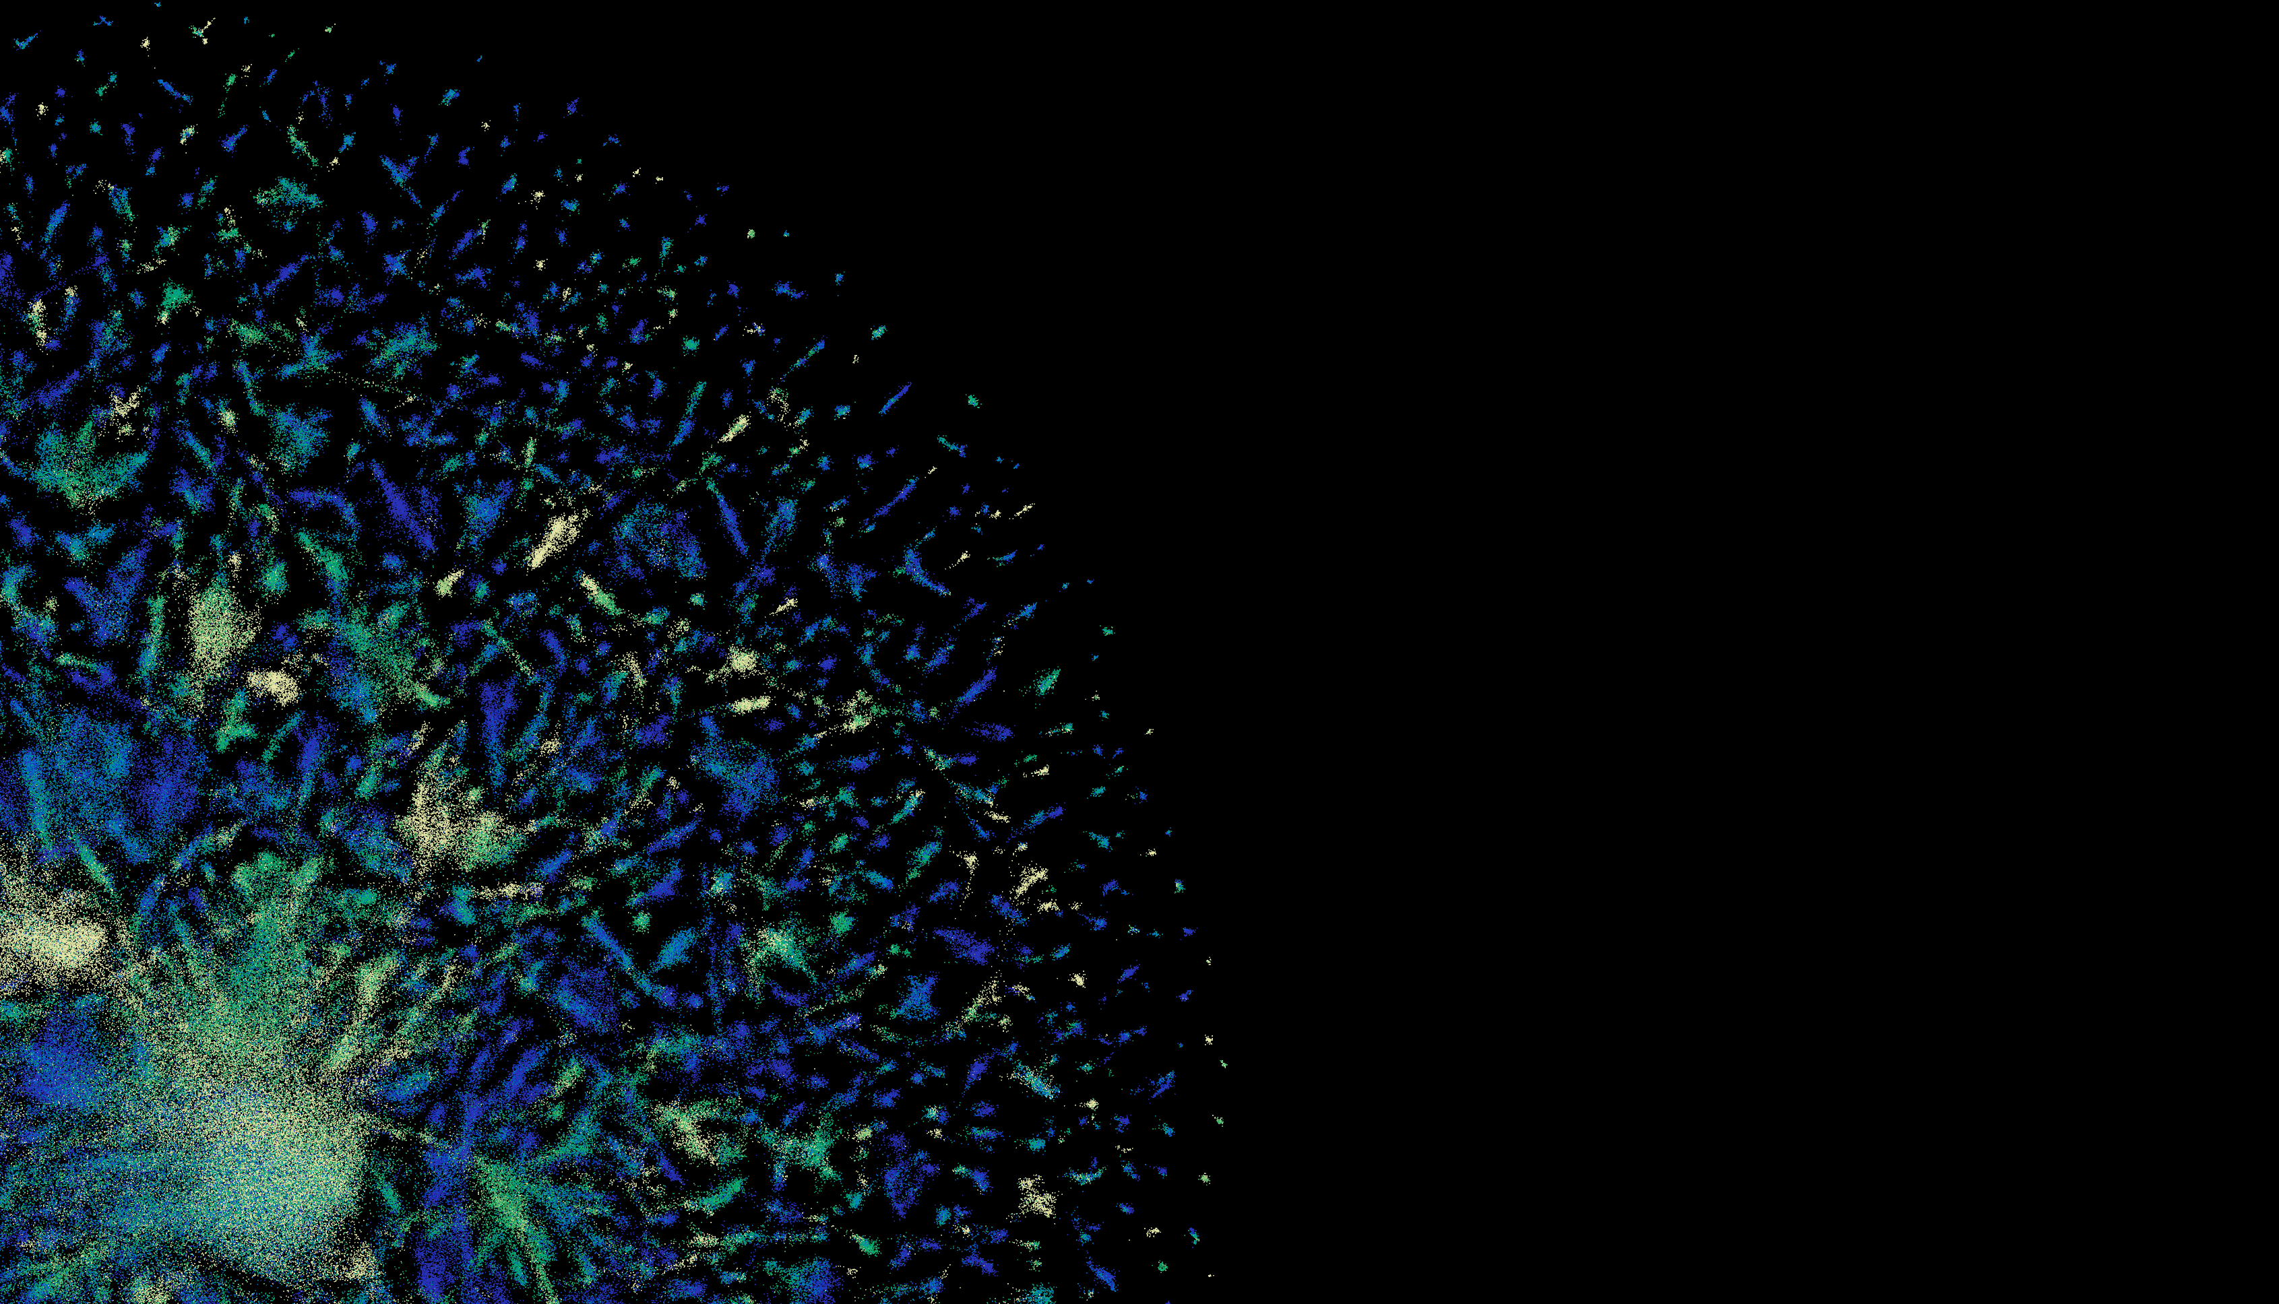


X'Fold' programs - co-evolution DeepLearning
DL: No physics of folding – Transformers – 1D sequence -> 3D structure
HPC & Hyperscalers: Batch, O(N²) VRAM, O(N³) time, fixed DBs, 1000s calcs, fast I/O
'Evo'formers (GPU+CPU+DBs)
Protein-LMs (GPU)
Diffusion GenAI (GPU)
(Alpha|Open|RoseTTA|Ab)Fold
ESMFold, ProtTrans
RFDiffusion, Chroma

Slide 6
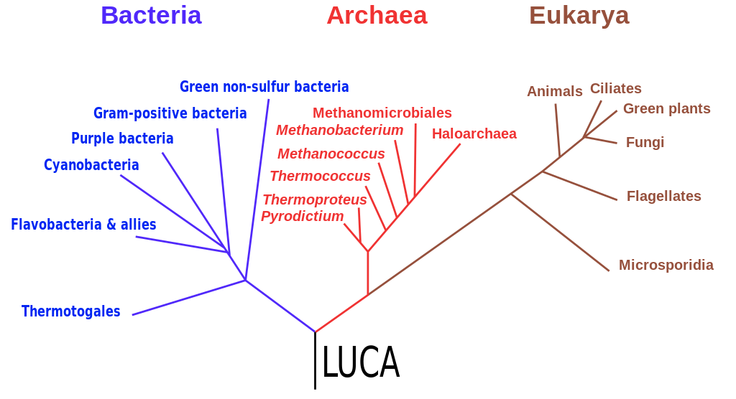


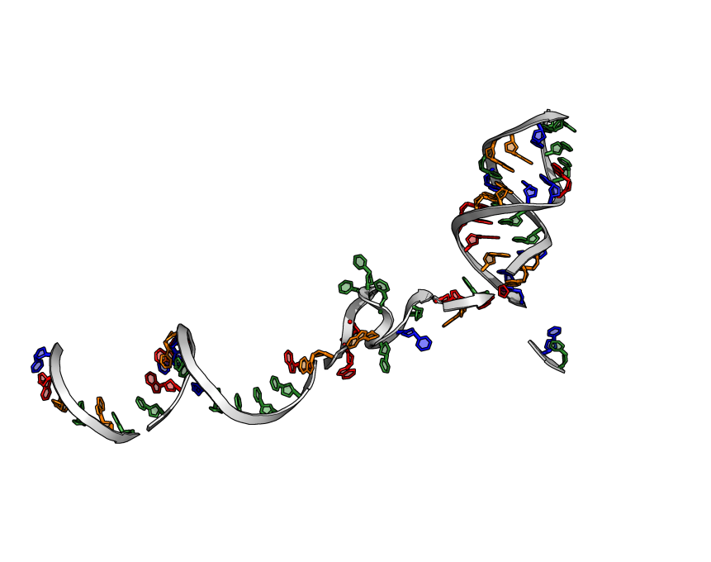
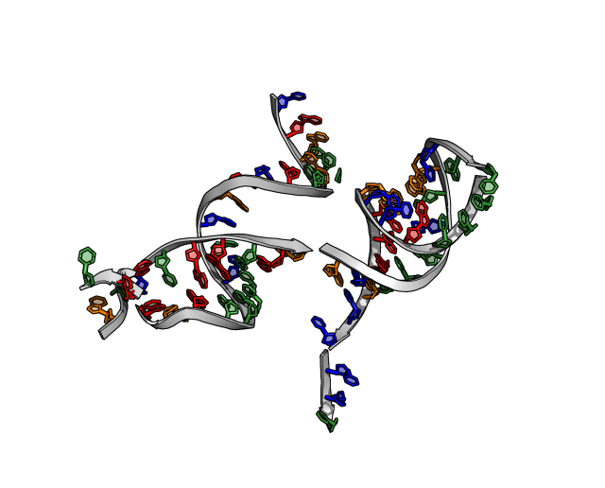

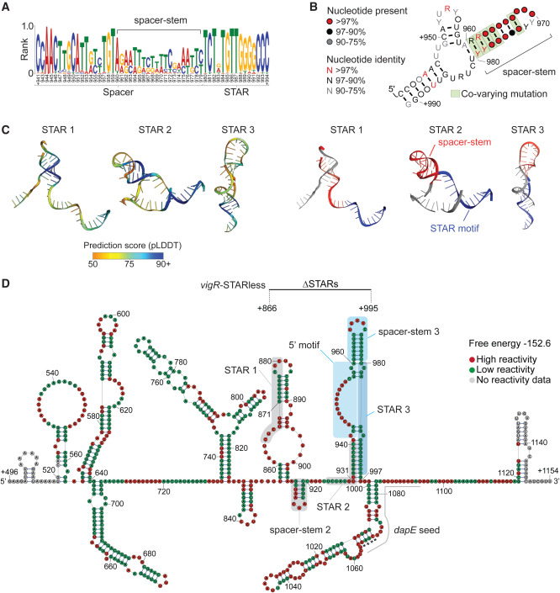
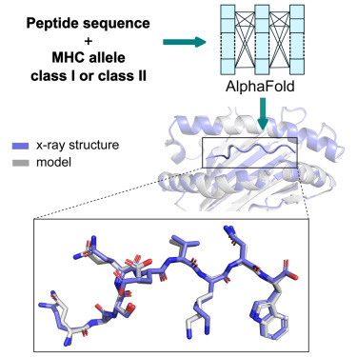
DL Biomolecular structures – Uses
Archaeal evolution – Michie/Burns Labs - ESMFold + FoldSeek
Sequence whole genome
Structural
4622 proteins
AFDB-search
Medical genomics – Oates Lab – RFoldNA
160 variants
Neural disease (genetic)
'Healthy population'
'Sick kid'
Antibiotic Resistance – Tree Lab – RFoldNA
Immune response – Tedla Lab – T(Cell)Fold
'Golden Staph'
vancomycin
tolerance via
RNA structures

Slide 7
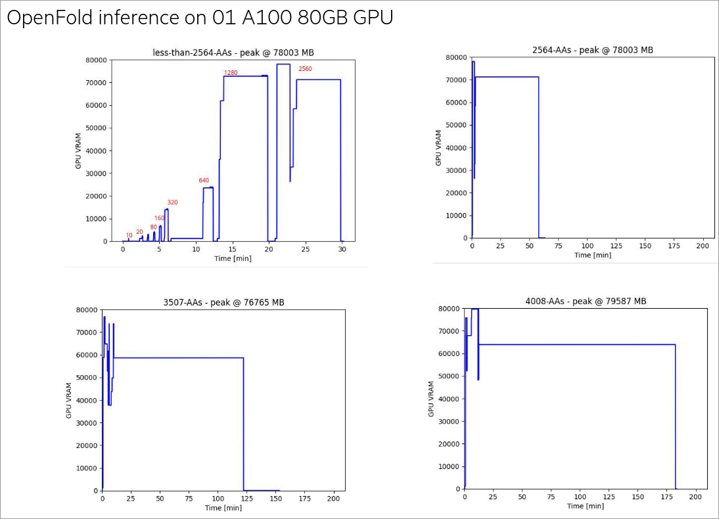
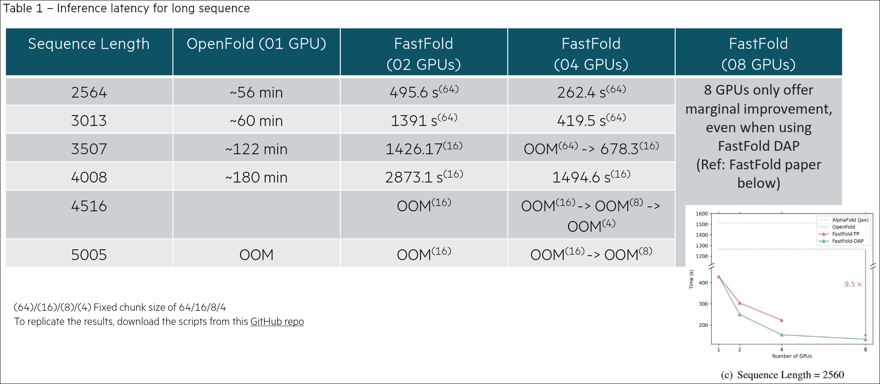
Workloads – Biomolecular Structures
(Alpha)Fold walltime:
Bulk fold a proteome (A100-40)
Archeal virus – 613 proteins – AlphaFold 22 days - ESMFold 8 hrs
Lokiarcheon – 4622 proteins – AlphaFold ??(2yrs) - ESMFold 10 days
National use (Galaxy Aus)
~15k AlphaFold jobs. Median 10, mean 83. Top user 1000s
55% of jobs are multiple proteins together - "multimers"
(Alpha)Fold VRAM use – courtesy of Daniel Cao @ HPE – thanks for benchmarking!
RFoldNA walltime: 160 variants in 24 hrs (A100-40)
RFDiffusion walltime: design ~100 scaffolds/hr, then AlphaFolded

Slide 8
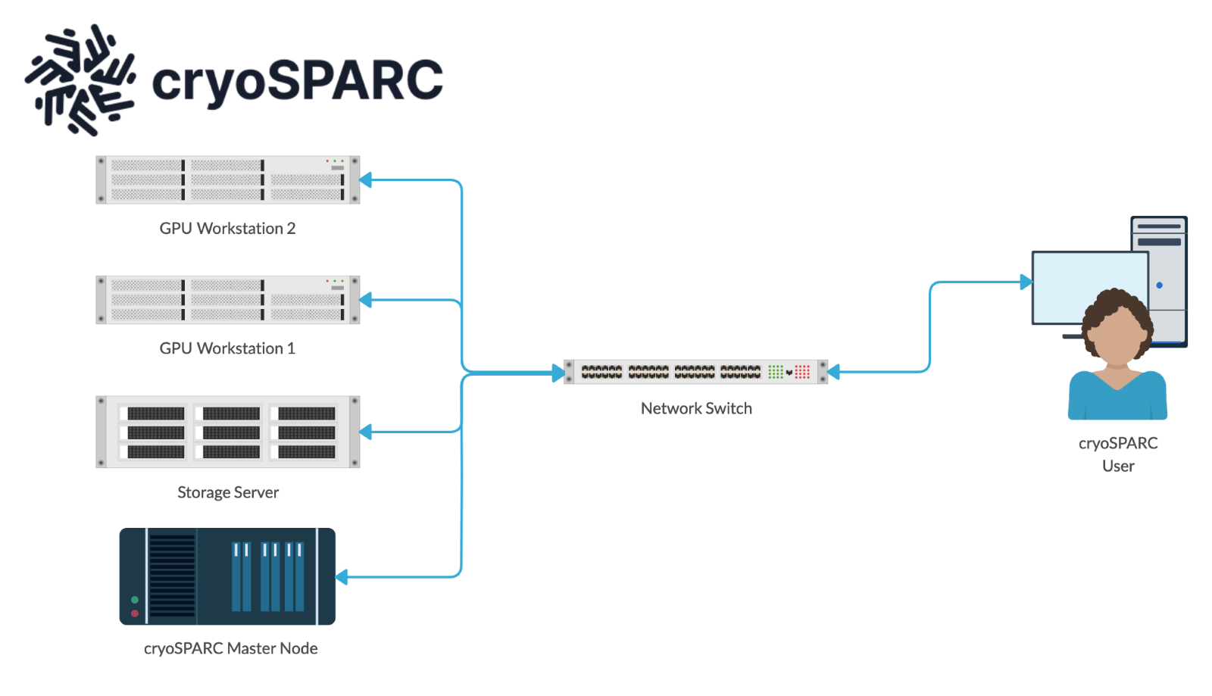
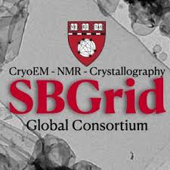
Cryo-Electron Density processing Evolving ecosystem of EM-image software
The best (for ease of use)
...and the rest
Relion
IMOD/Etomo
EMAN2
MotionCor2
Gctf
Scipion (Spanish CryoEM competitor to SBGrid)
ISOLDE (interactive Molecular Dynamics refinement)
App-like user-friendly web interface, port forward
Most popular suite, but not feature-complete
Supports PBSPro integration for long image jobs
Iterative refinement, not 'set-and-forget' batch
Different graphics stacks (XCB/OpenGL, direct/indirect render)
Some programs (e.g. IMOD) recommend against VNC remote view
Monash 'MASSIVE' data visualisation HPC supports some programs
555 popular Structural Biology packages
Version and dependency control (CUDA)
UniMelb (Spartan) has SBGrid module
source /programs/sbgrid.shrc

Slide 9
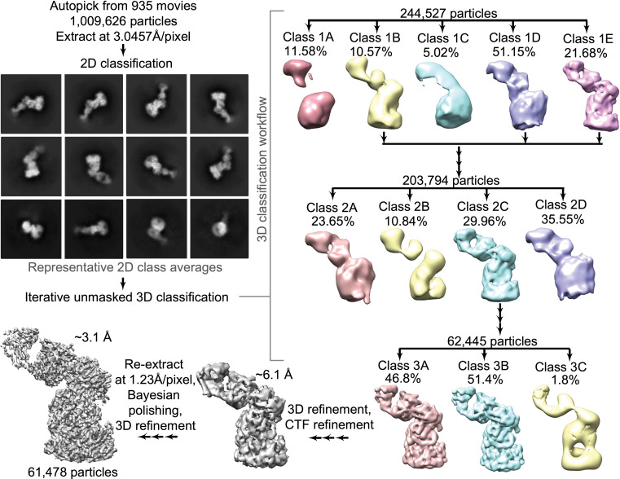
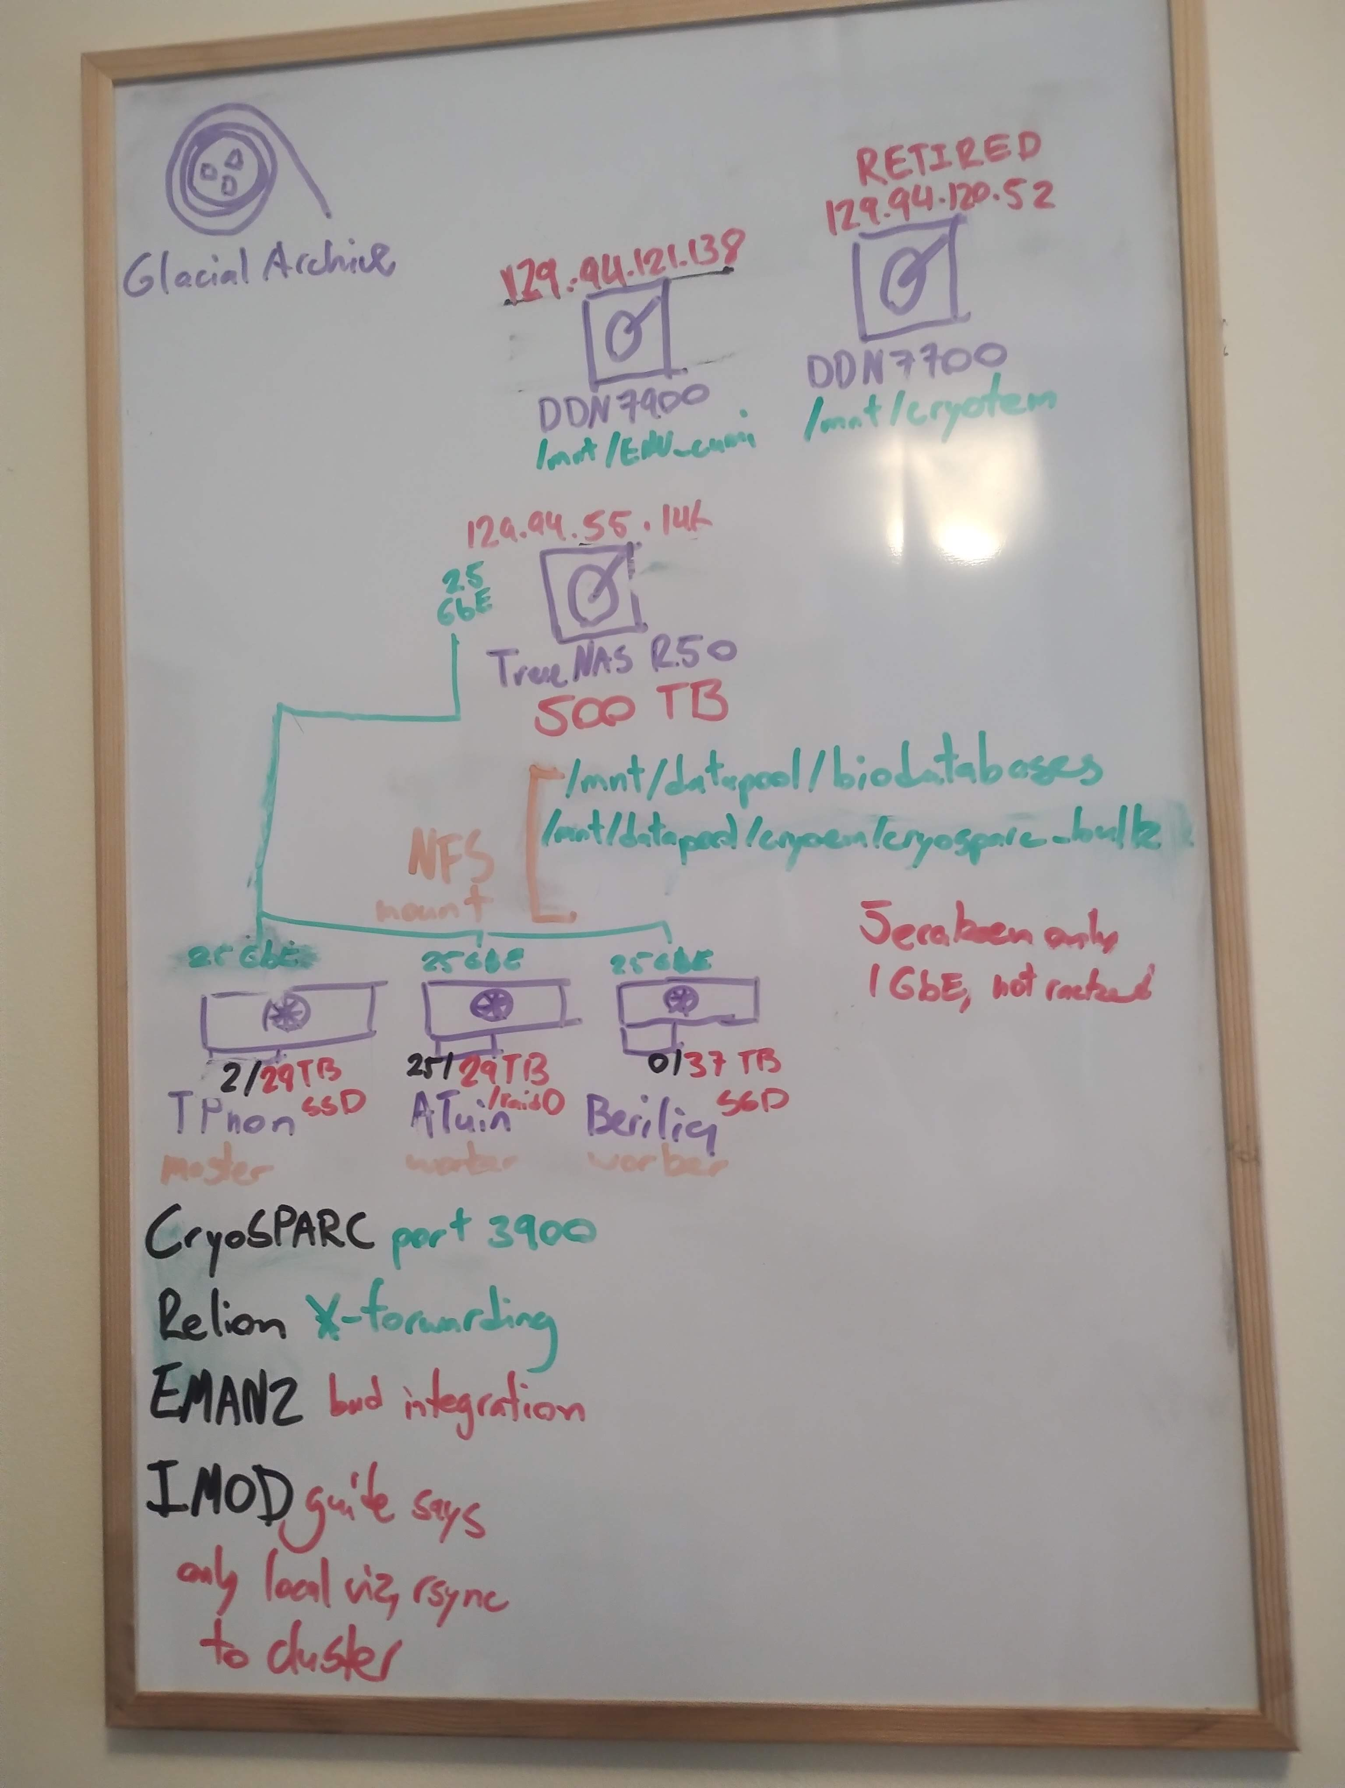
Workloads – CryoEM data transfer
CryoEM structure determination – reprocess movies
Nguyen T.; Song J.; STAR Protocols 2(4):100852
TBs of movie files to transfer from EMU
(currently cifs share mounted on worker, want to change)
'On-the-fly' very useful (Daniel Luque)
Largely CryoSPARC portal
Remote desk (RustDesk) fallback

Slide 10
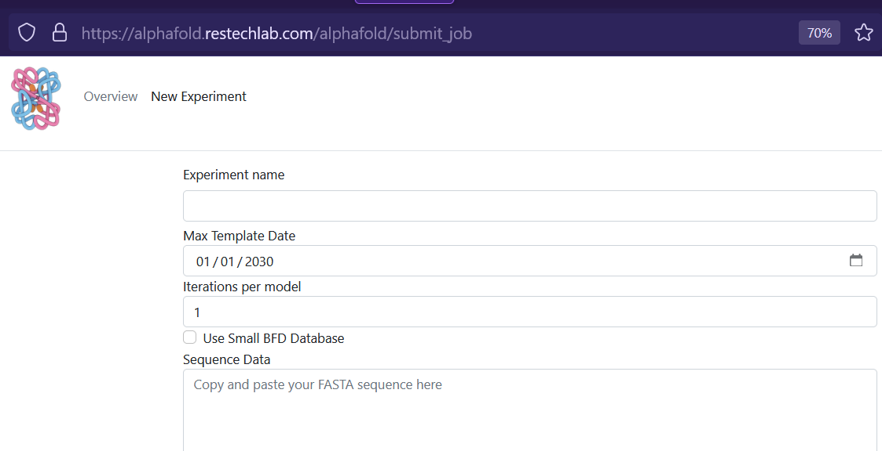
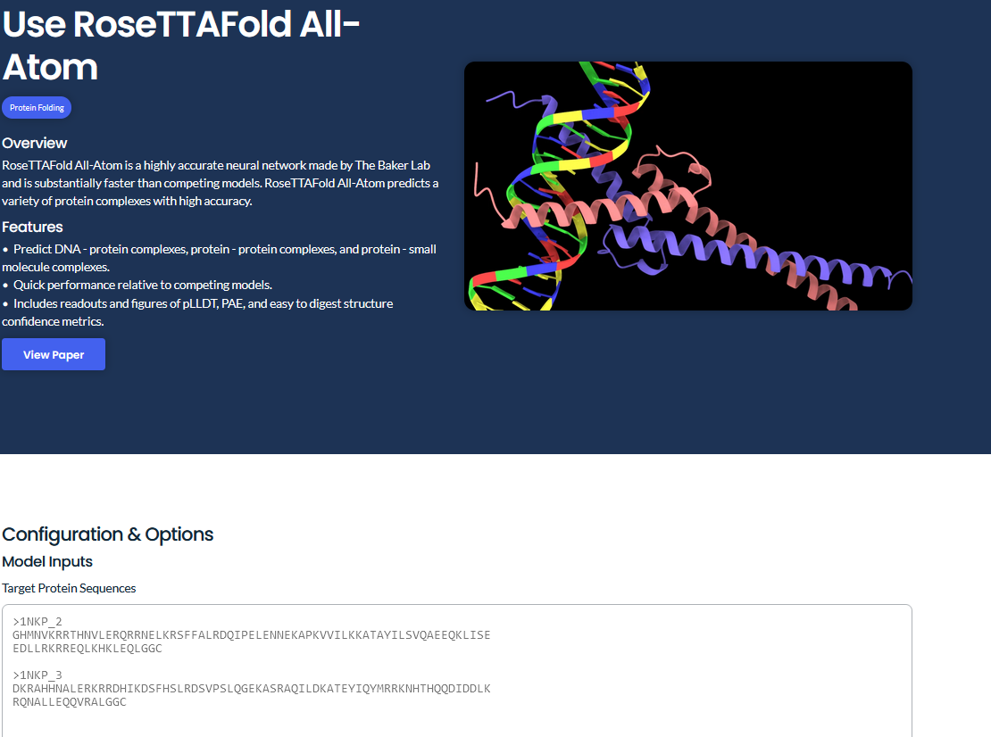
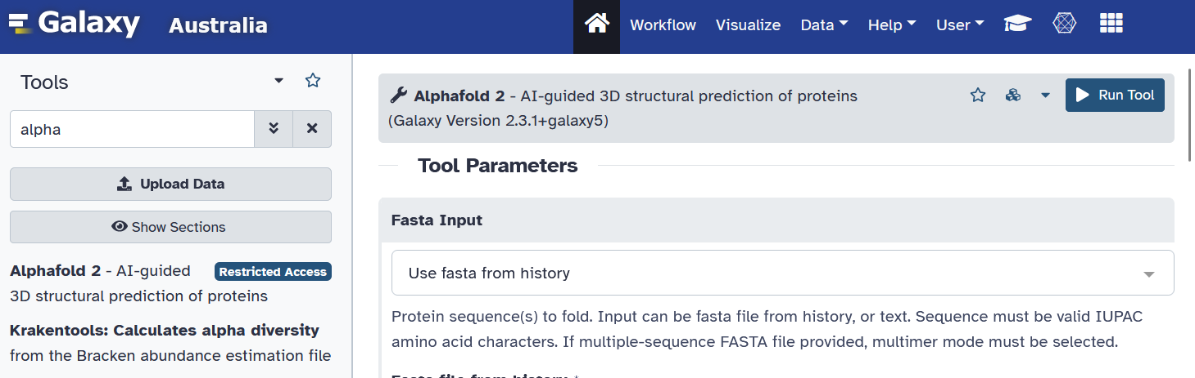
Improved Workflows – HPC + Network
Data transfer – couple TBs/day/CryoEM scope -> GPU worker SSD cache
Next gen storage – I/O-bound, >4x AlphaFold sequence align – 7x CryoEM
GPU nodes for structure prediction – new Hopper-141GB nodes
GPU/CPU pipelines - BioCommons NextFlow proteinfold - NCI/Pawsey
More efficient methods – MMSeq2 faster sequence alignment, ESMFold
Interface wet-lab scientist friendly - nice defaults, no CLI learning
usegalaxy.org.au
neurosnap.ai
alphafold.restechlab.com

Slide 11
What's the Future for compute in Struct Bio?
Protein-Interaction screening:
CoFolding large #s of proteins and drug candidates
Workflow integration with sequence data:
Ramaciotti RNASeq data in Katana -> workflow to RFoldNA 3D predictions
CryoEM <-> AlphaFold cross talk:
Experimental density maps will help de novo structure prediction and vice versa
Molecular Dynamics:
AlphaFold produces single static structures
GPU Quantum Chemistry of whole proteins:
AlphaFold skips molecular physics. QDX (Barca group) has protein-scale QM calcs

Slide 12
Questions / Discussion
How to make these tools accessible

